Slide 1
Statistics Project
Gas Turbine Emissions and AI4I Maintenance Analysis

Slide 2
Table of content
1.
2.
3.
4.
Introduction
Gas Turbine Emissions Analysis
AI4I Analysis
Conclusions

Slide 3
1.
Introduction

Slide 4






Our Group
Donia Ben Othman
Yosr Lassoued
Skander Kechaou
Rania Souei
Arij Mahouechi
Youssef Ressaissi

Slide 5
Context
Gas Turbine CO and NOx Emission Data:
Origin: Collected from a gas turbine located in Turkey.
Data Characteristics: Includes 11 sensor measures aggregated over one hour, totaling 7,384 observations from 2015.
Goal: Understand and model relationships between emissions (CO and NOx) and environmental/operational variables (e.g., ambient temperature, pressure, and humidity).
AI4I 2020 Predictive Maintenance Dataset:
Origin: A synthetic industrial dataset representing predictive maintenance scenarios.
Data Characteristics: Contains 10,000 observations with variables like product quality variants, rotational speed, torque, and machine failures.
Goal: Investigate patterns of machine failures and relationships between process parameters and quality metrics.

Slide 6
Problematic
Emissions Prediction:
Assess how environmental and operational factors influence CO and NOx emissions in gas turbines.
Develop regression models to predict emissions and identify key drivers.
Failure Analysis:
Analyze the relationship between product quality, operational parameters, and machine failure rates.
Use statistical insights to enhance predictive maintenance and equipment efficiency.
Statistical Relationships:
Investigate correlations among key variables to inform decision-making.
Validate model assumptions of normality, linearity, and homoscedasticity.
Data Optimization:
Apply statistical methods (ANOVA, T-tests, chi-square) to confirm the significance of patterns.
Address the impact of outliers and non-linear relationships on model reliability.

Slide 7
2.
Gas Turbine Emissions Analysis

Slide 8
Dataset Overview
Five datasets spanning 2011 to 2015.
Aggregated data of gas turbine operational parameters and emissions.
Key Variables:
CO (Carbon Monoxide): Dependent variable.
NOx (Nitrogen Oxides): Secondary variable of interest.
Independent variables:
Ambient Temperature (AT).
Ambient Pressure (AP).
Ambient Humidity (AH).
Air Filter Difference Pressure (AFDP).
Gas Turbine Exhaust Pressure (GTEP).
Turbine Inlet Temperature (TIT).
Turbine After Temperature (TAT).
Compressor Discharge Pressure (CDP).
Turbine Energy Yield (TEY).

Slide 9
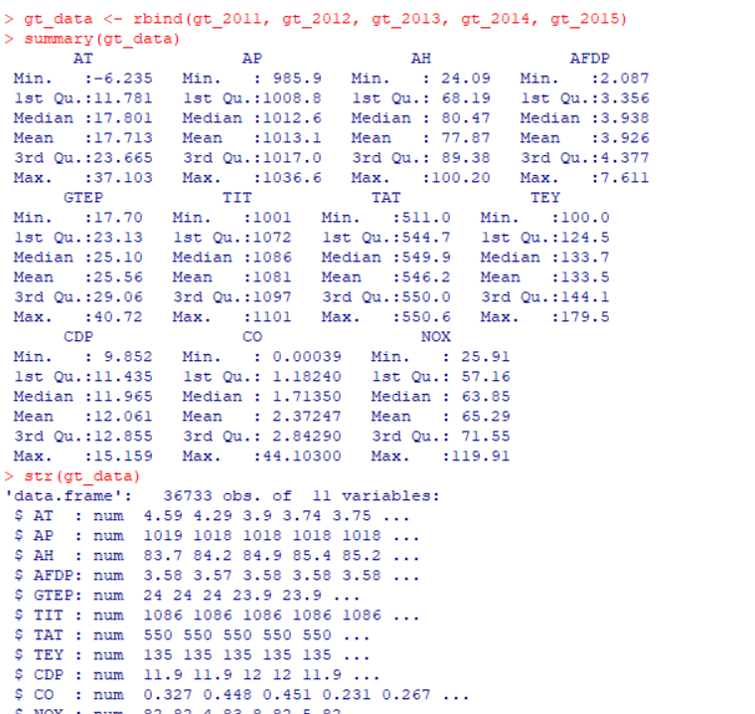

Slide 10
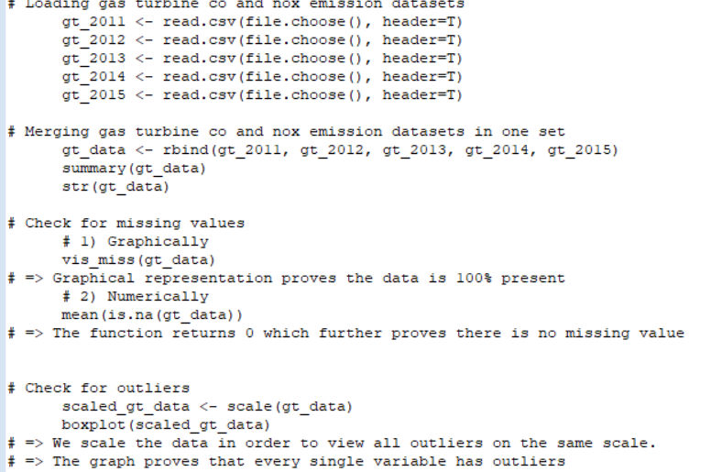
Data Loading and Preparation
Steps:
Imported datasets for each year (2011–2015) using read.csv.
Combined them into a single dataset using rbind.
Checked for missing values:

Slide 11
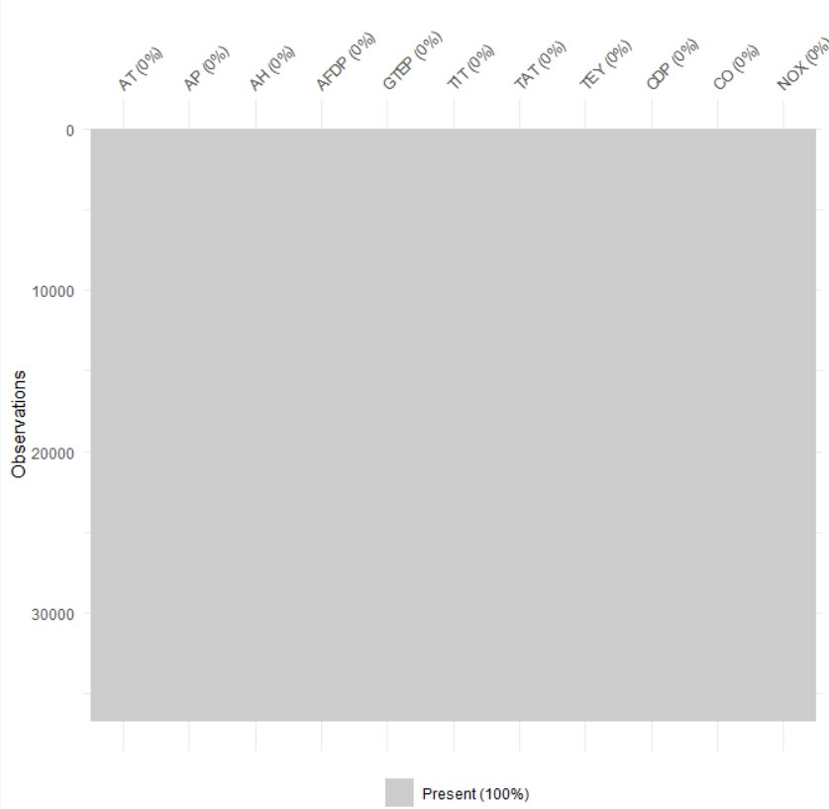

Check for missing values
Graphically: Used vis_miss() for a visual check, confirmed no missing data.
Numerically: Used mean(is.na(data)), returning 0, further confirming no missing values.
Summary Statistics:​​
Variables had varying ranges, means, and standard deviations.​​
Structure (str()) confirmed consistent data types.​​

Slide 12
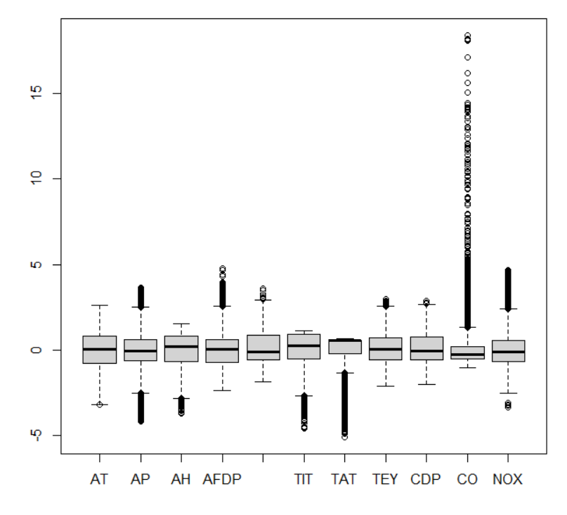
Outliers and Imputation
Outliers Detected:
Boxplots of scaled data (scale()) showed outliers in nearly every variable.
The graph proves that every single variable has outliers

Slide 13
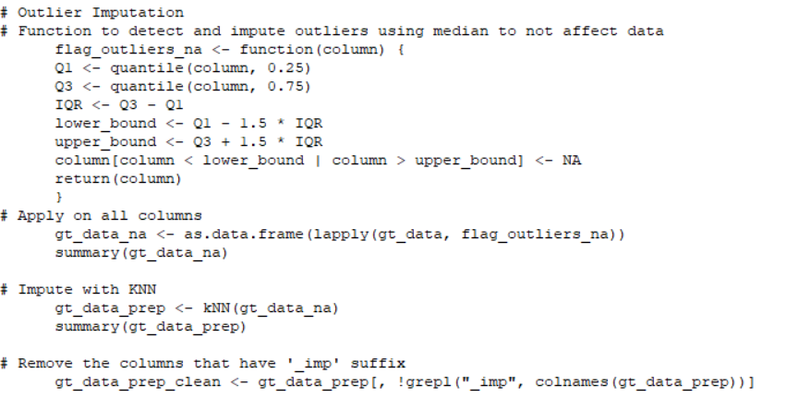
Imputation Process:
Developed a function (flag_outliers_na) to replace outliers with NA using the interquartile range (IQR) method:
Lower bound = Q1 - 1.5 × IQR.
Upper bound = Q3 + 1.5 × IQR.
Applied the function across all columns.
Used KNN (by default 5) imputation to fill NA values, preserving data relationships.

Slide 14
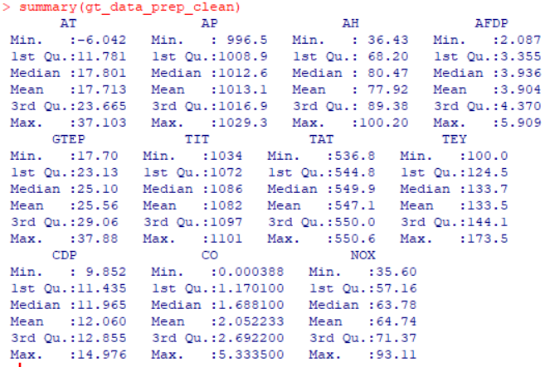
Let's check the cleaned Data

Slide 15
Correlation Analysis
We will check relationships and correlation between variables with our cleaned data in order to understand the linearity

Slide 16
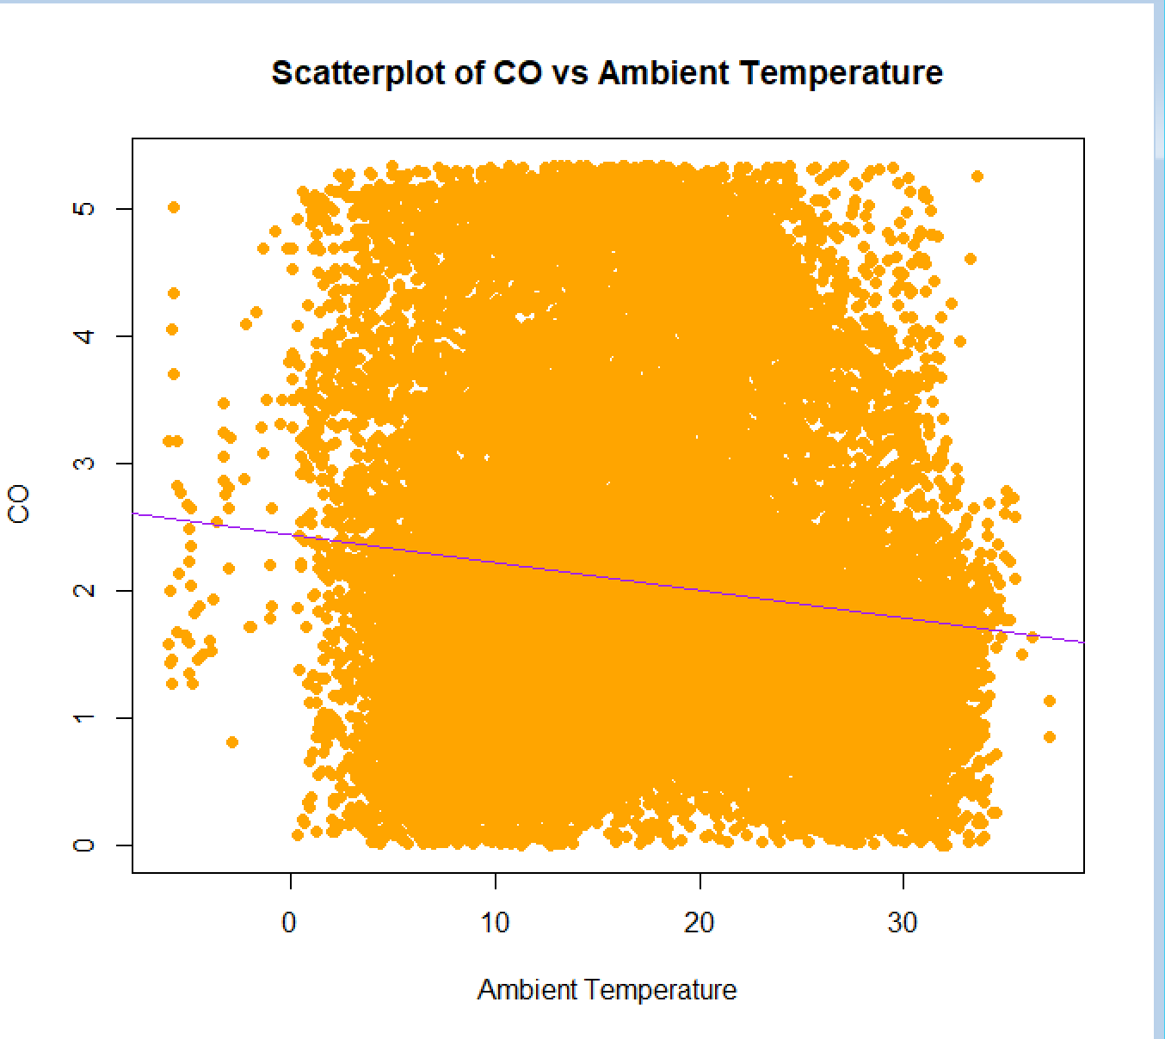
Check relation between independant variables and target CO graphically CO and Ambient Temperature
We can tell CO and AT aren't related because the points are loosely scattered

Slide 17
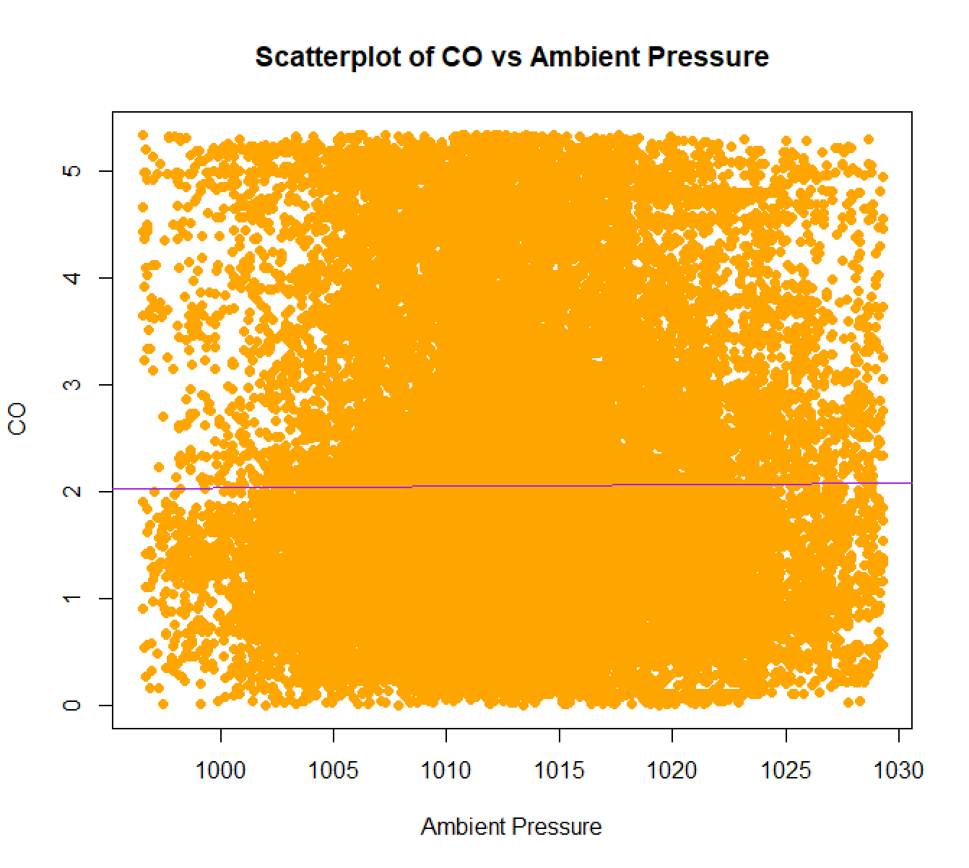
Check relation between independant variables and target CO graphically CO and Ambient Pressure
We can tell CO and AP aren't related because the points are loosely scattered

Slide 18
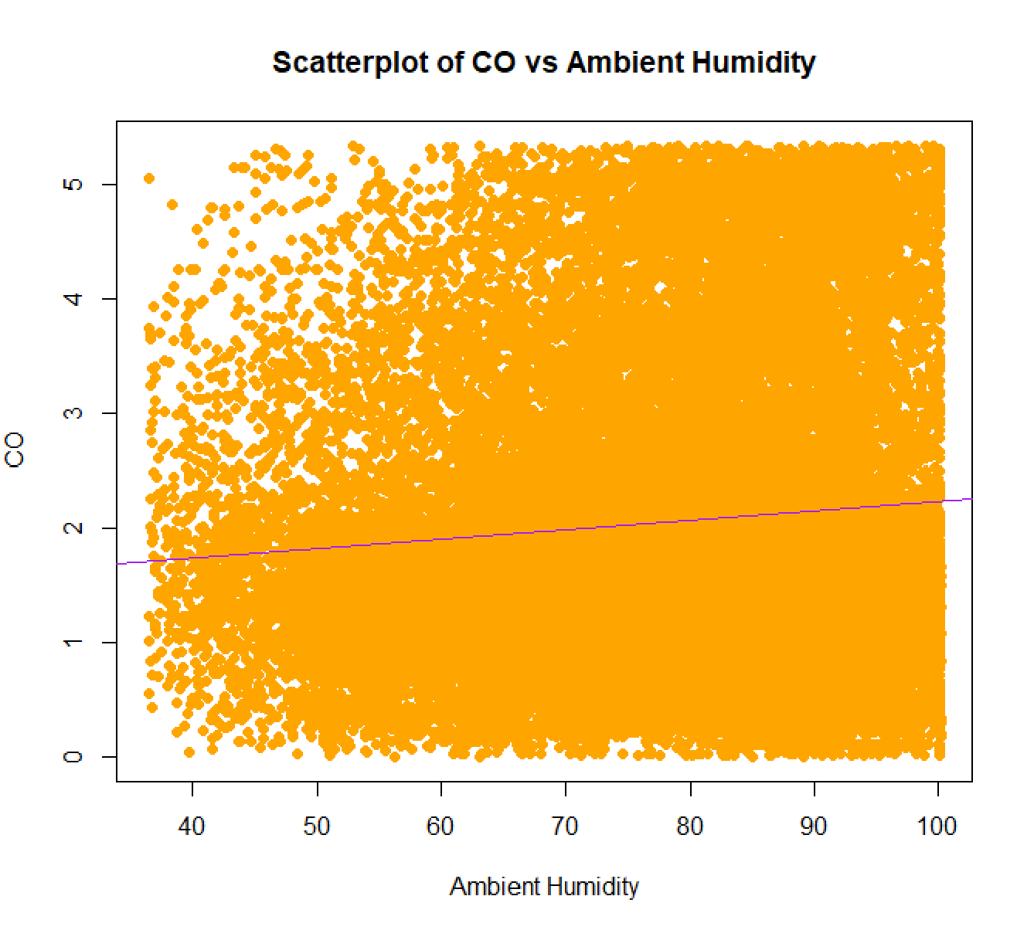
Check relation between independant variables and target CO graphically CO and Ambient Humidity
We can tell CO and AH aren't related because the points are loosely scattered

Slide 19
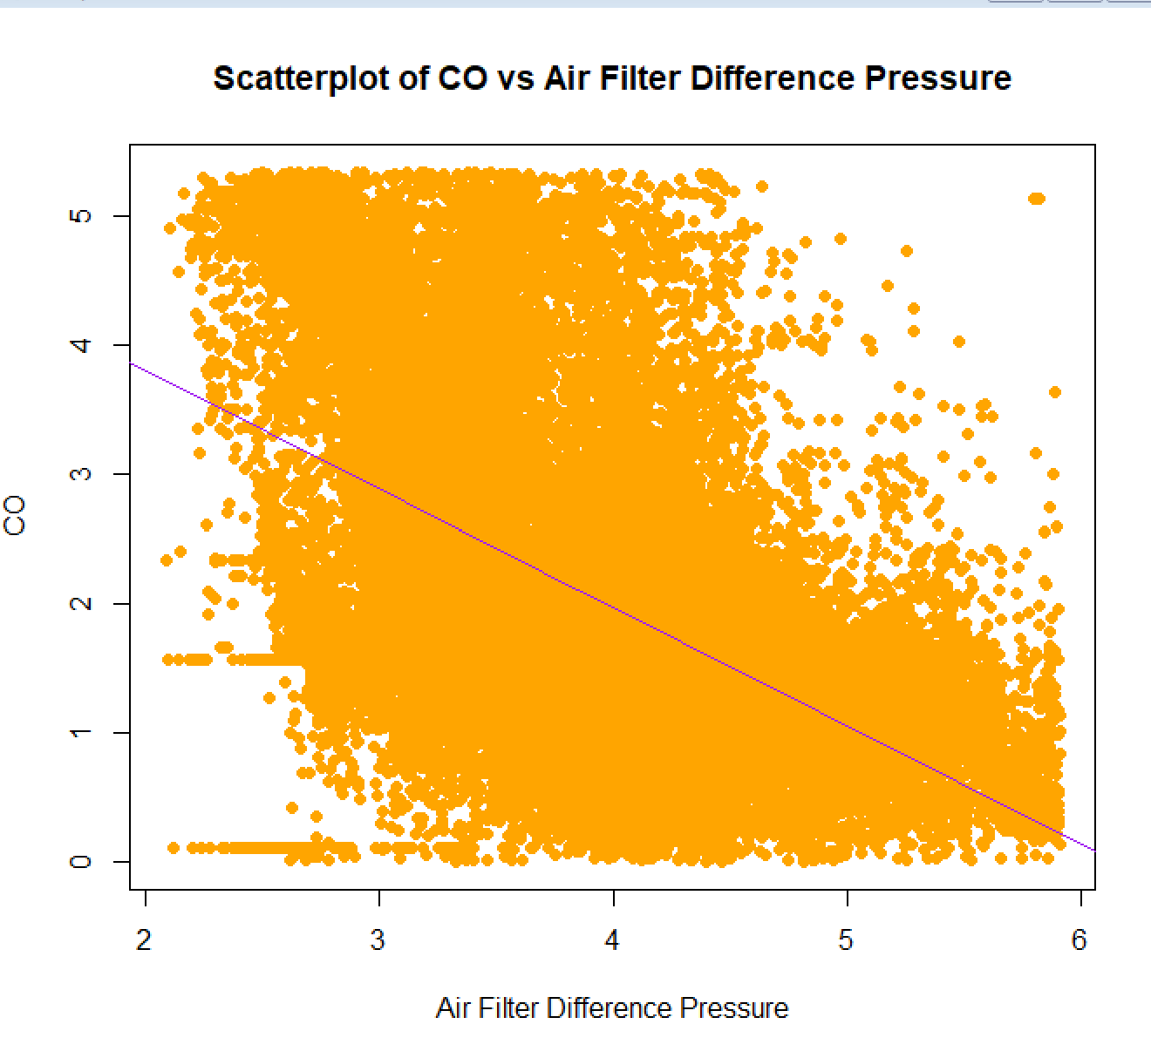
Check relation between independant variables and target CO graphically CO and Air Filter Difference Pressure
As the x-axis variable increases, the y-axis variable decreases.
We can tell CO and AFDP have a negative relationship

Slide 20
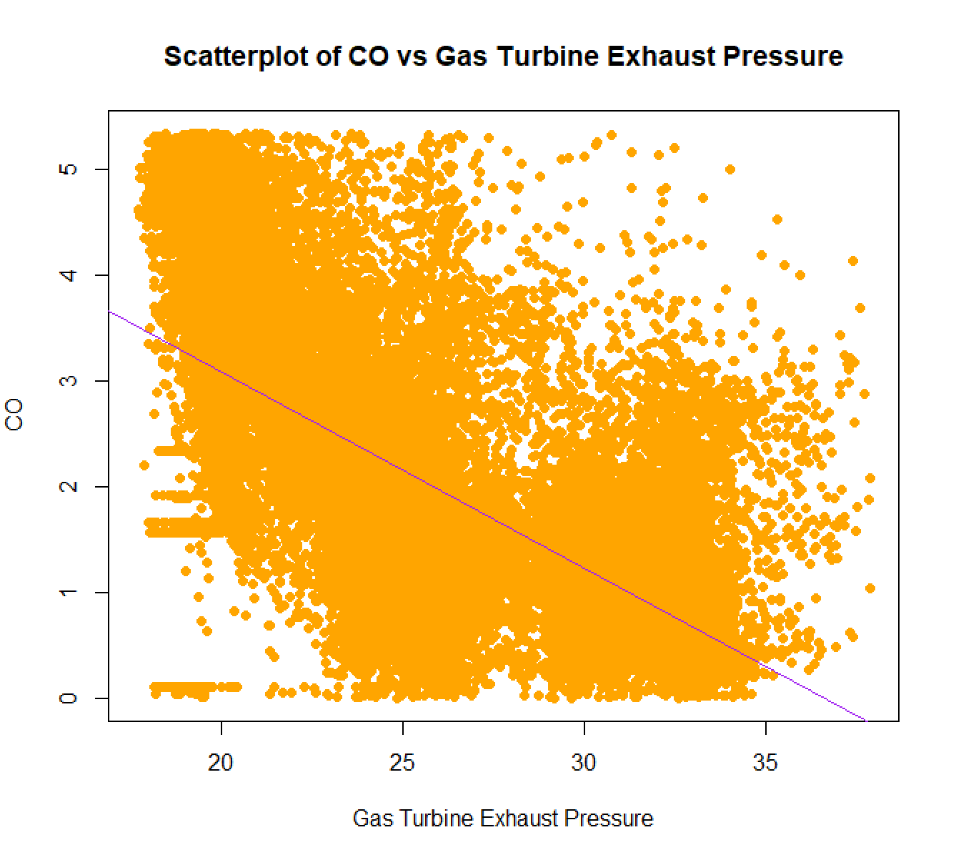
Check relation between independant variables and target CO graphically CO and Turbine Exhaust Pressure
As the x-axis variable increases, the y-axis variable decreases.
We can tell CO and GTEP have a negative relationship

Slide 21
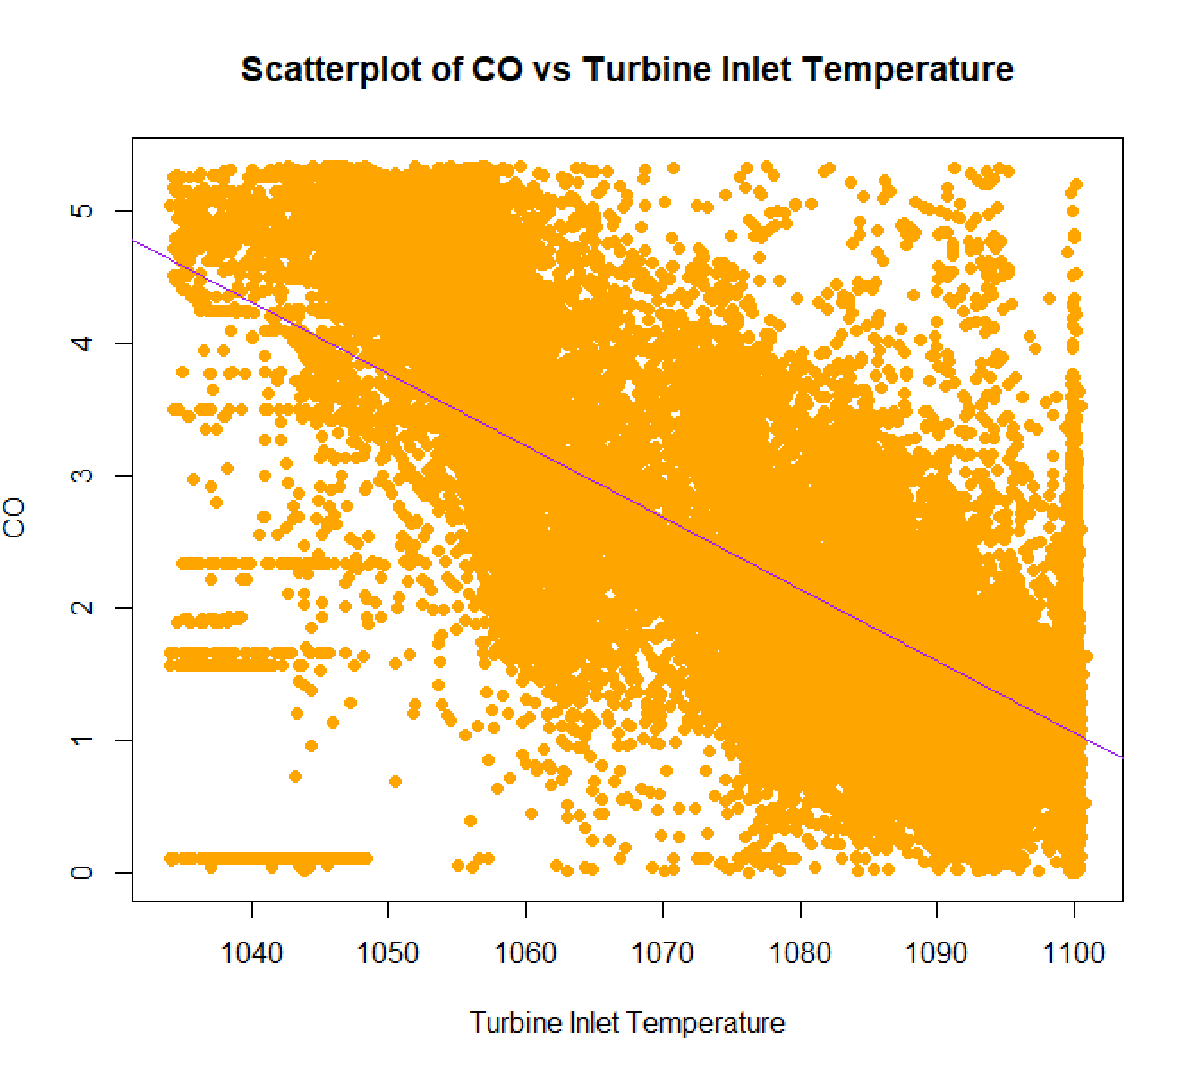
Check relation between independant variables and target CO graphically CO and Turbine Inlet Temperature
As the x-axis variable increases, the y-axis variable decreases.
We can tell CO and TIT have a negative relationship

Slide 22
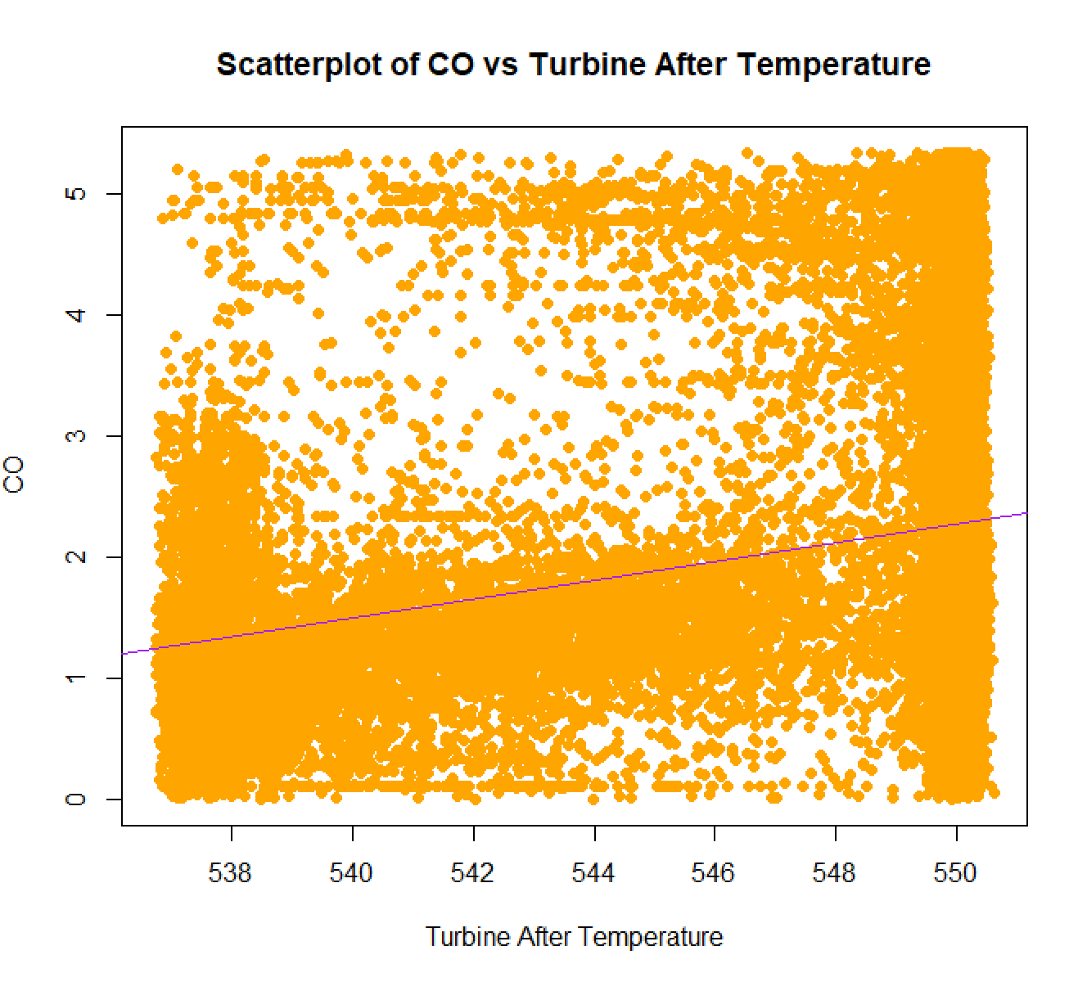
Check relation between independant variables and target CO graphically CO and Turbine After Temperature
We can tell CO and TAT aren't related because the points are loosely scattered

Slide 23
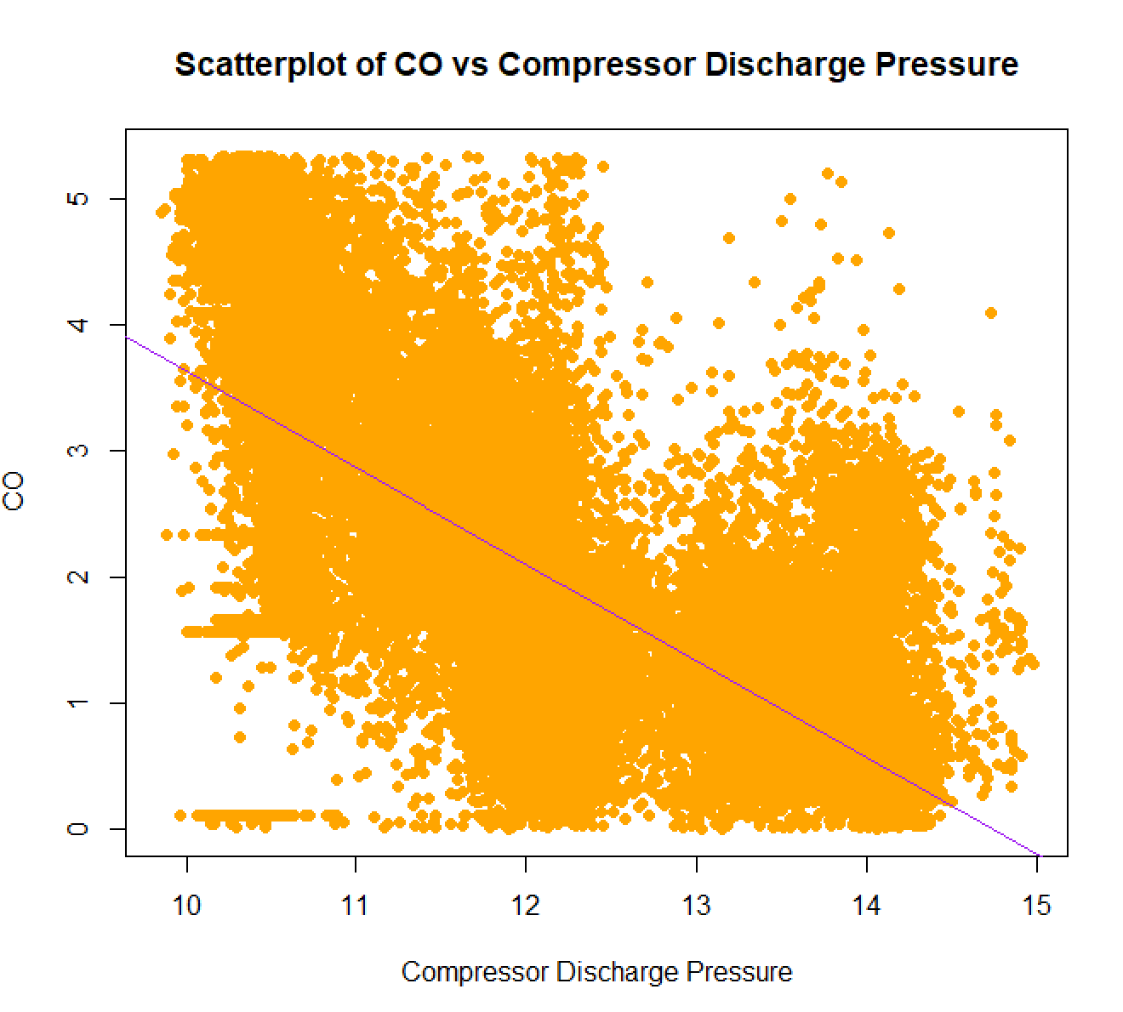
Check relation between independant variables and target CO graphically CO and Compressor Discharge Pressure
As the x-axis variable increases, the y-axis variable decreases.
We can tell CO and CDP have a negative relationship

Slide 24
Check relation between independant variables and target CO graphically CO and Compressor Discharge Pressure
As the x-axis variable increases, the y-axis variable decreases.
We can tell CO and CDP have a negative relationship

Slide 25
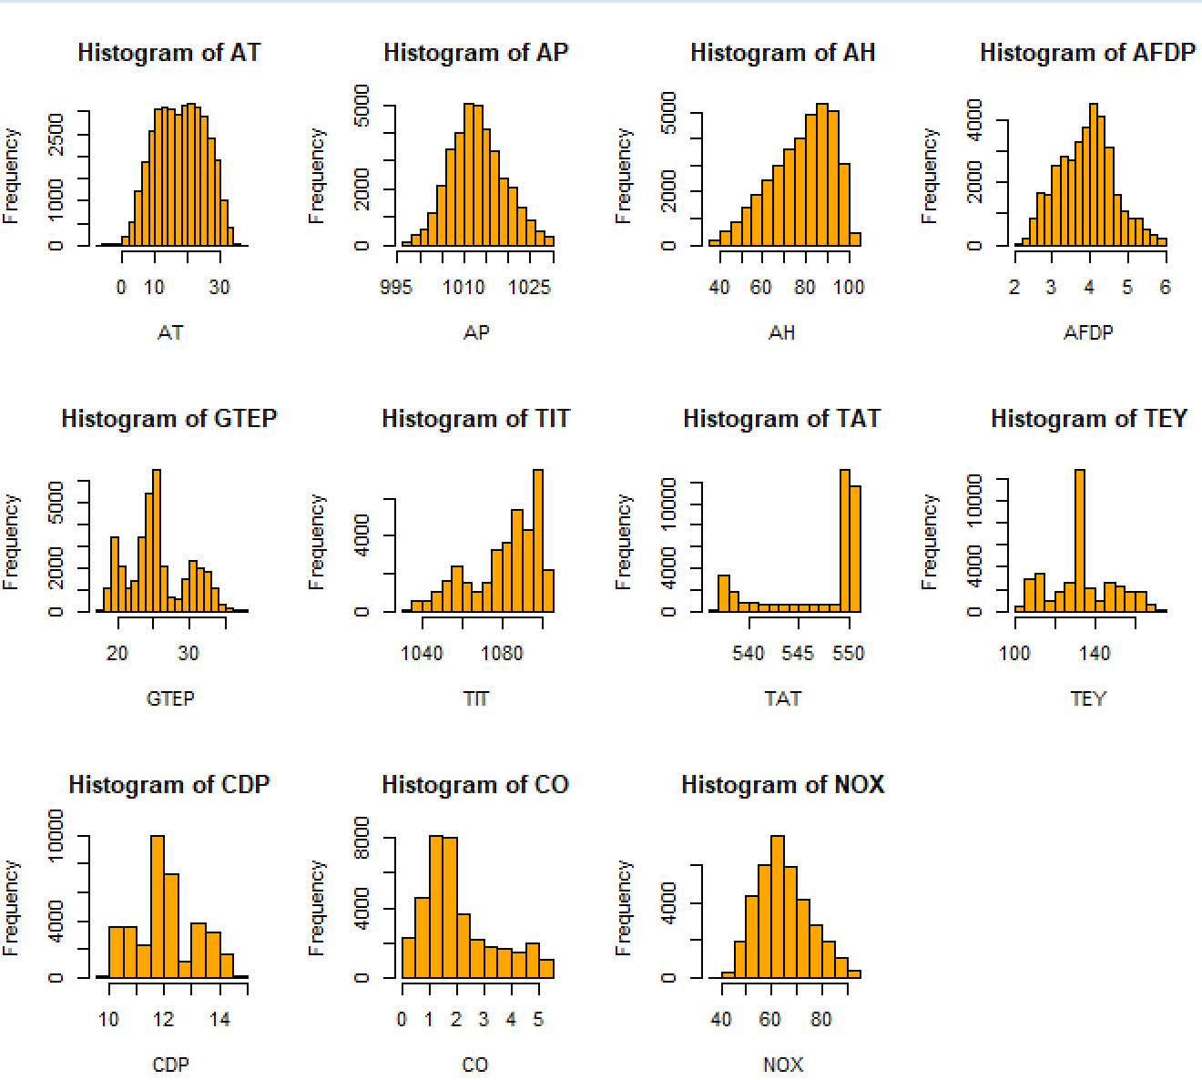
Variable normality test
Mars
We can remark that all of our variables don't follow a normal distribution
Mars is actually a very cold place
Jupiter
Jupiter is the biggest planet of them all

Slide 26
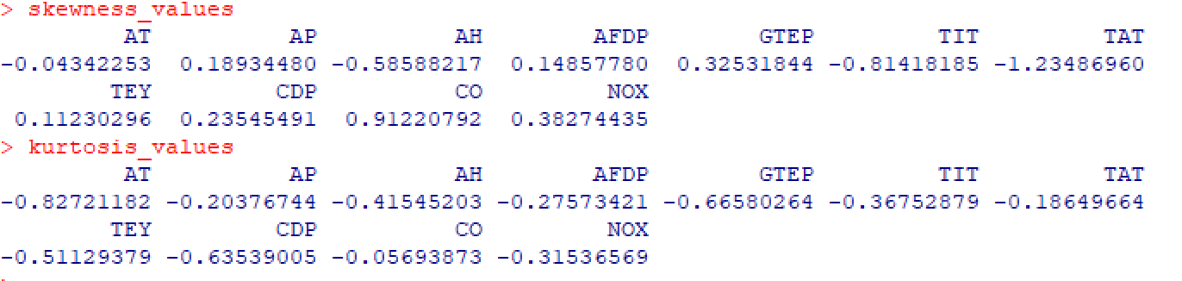
Skewness and Kurtosis tests
-Most of our variables are close to symmetric (~0) or have mild skewness except TAT
-Most of our variables have low kurtosis < 3 except TAT who's kurtosis > 4

Slide 27
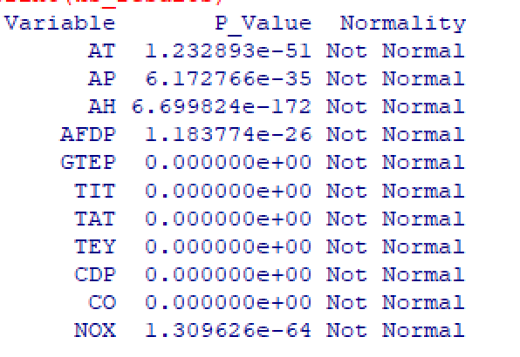
Skewness and Kurtosis tests
In conclusion, given the very small p-values (all < 2.2e-16), none of the variables in our dataset follow a normal distribution.

Slide 28
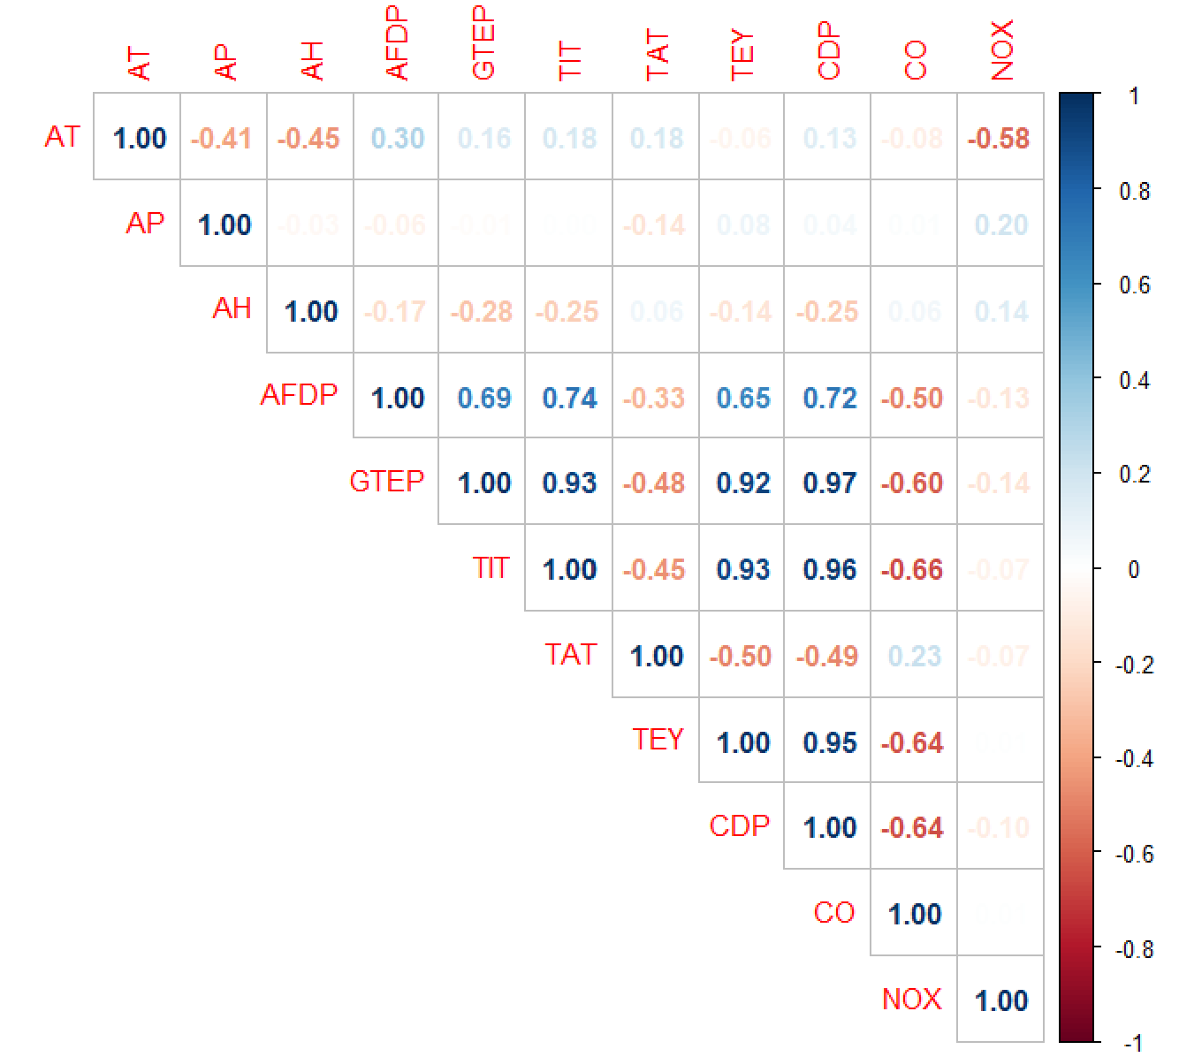
We will use Spearman instead of Pearson because it doesn't need normality.
As a matter of fact, TIT has the strongest relationship with CO (-0.59) followed by CDP, TEY, GTEP and AFDP, whereas NOX only has a strong relationship with AT (-0.6) meaning as temperature decreases, NOX increases.
However, GTEP, TIT, TEY and CDP have strong relationships with each other They provide the same information and we need to remove some variables.

Slide 29
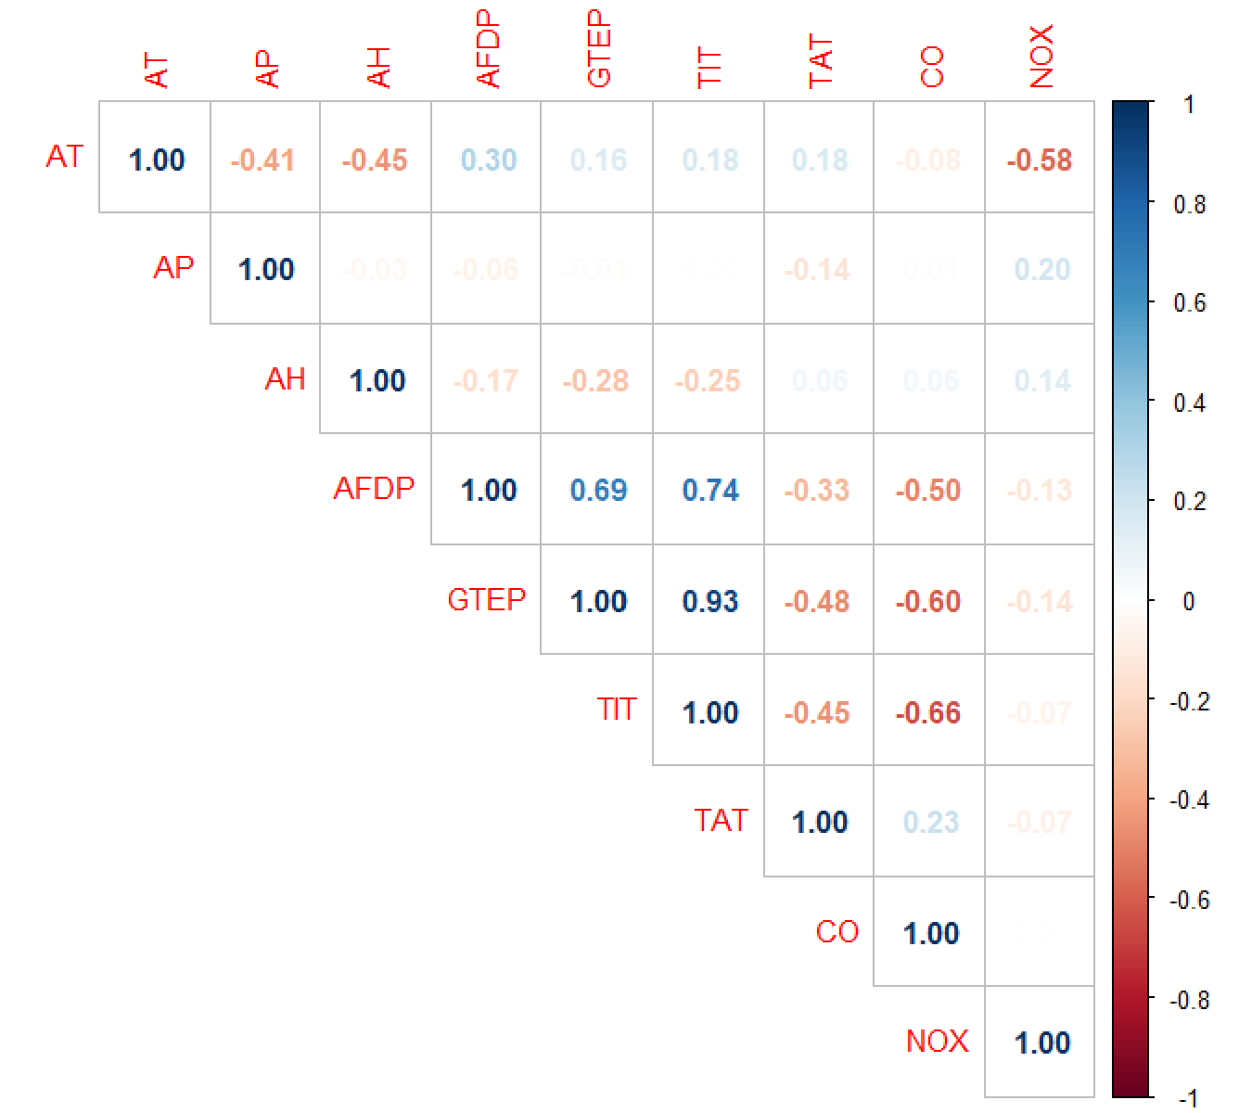
We will use Spearman instead of Pearson because it doesn't need normality.
We remove CDP and TEY because they have the strongest multicolinearility problem.

Slide 30
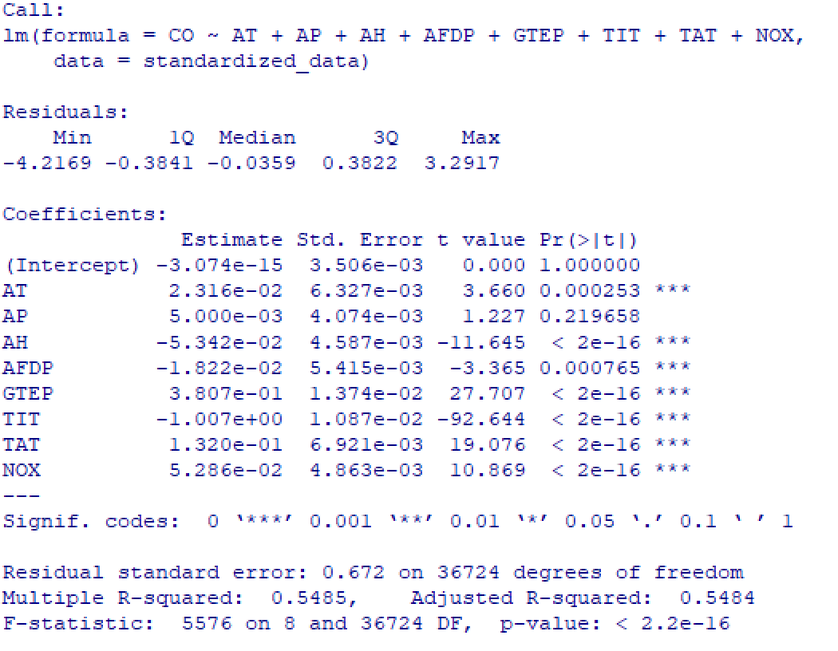
Regression Analysis
We will normalize our dataset (using Z-score)
Then render the Full model with all predictors

Slide 31
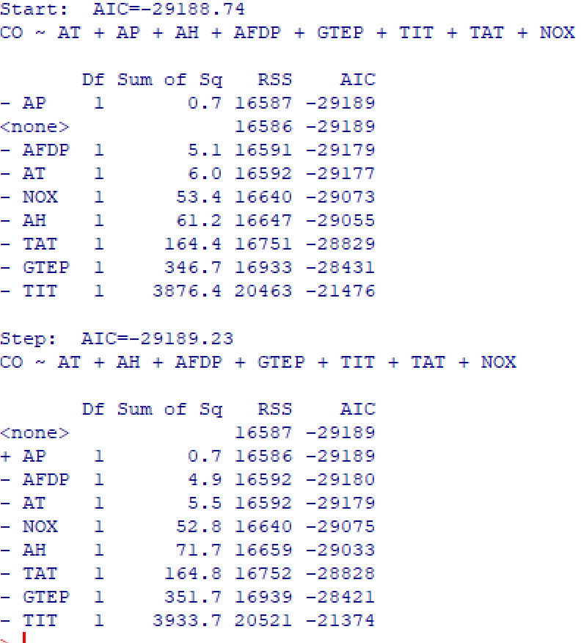
Perform stepwise regression
We selected the most statistically significant variables while removing those that do not contribute much to the predictive power.
AP was removed

Slide 32
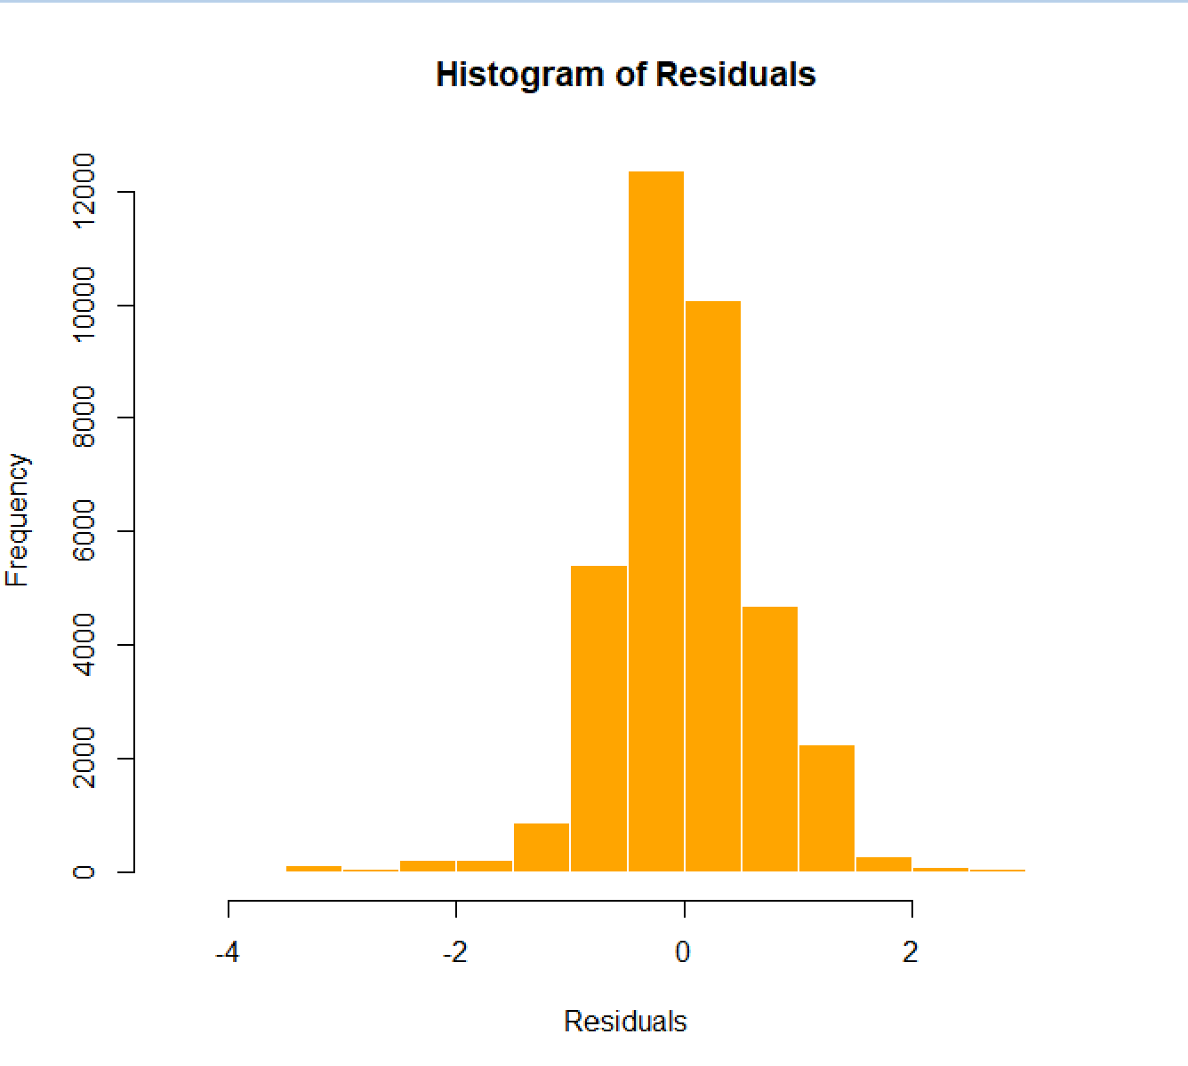
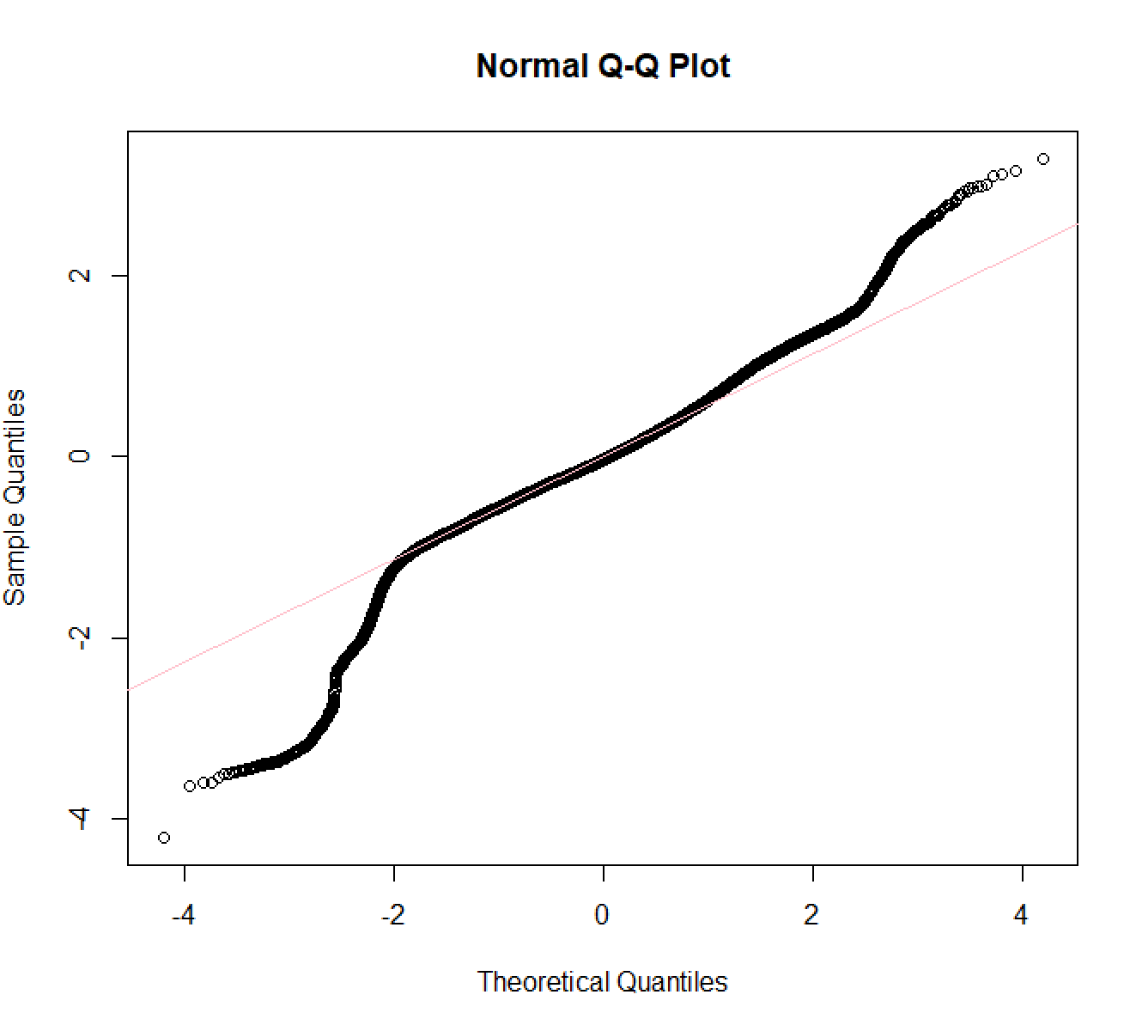
Residuals
The residuals seem to not follow a normal distribution

Slide 33
Skewness and Kurtosis
Skewness =-0.3155165
Kurtosis = 2.849498
it's close to 0 meaning it's symmetric
it's less than 3 meaning it's lightly tailed

Slide 34
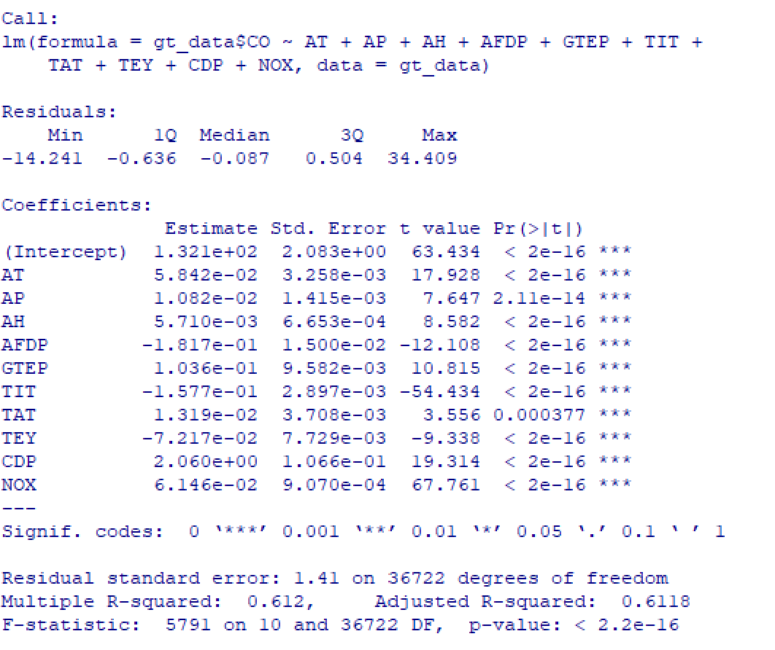
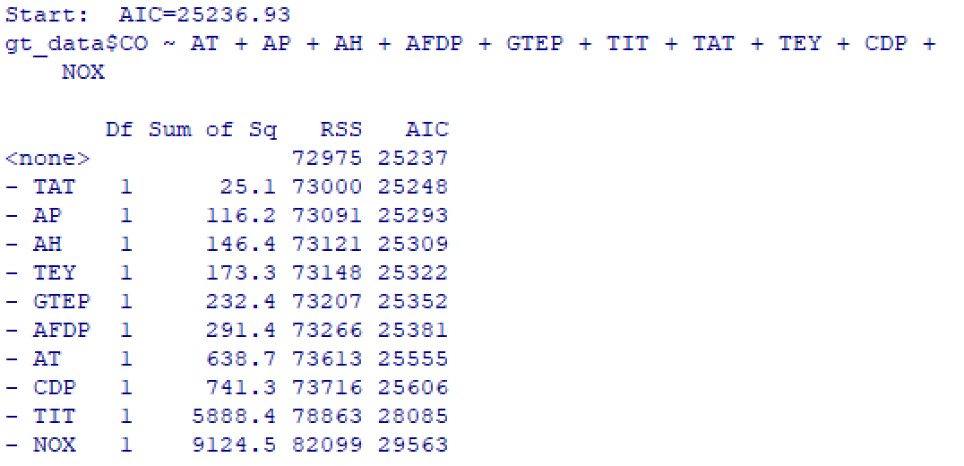
R-squared
R-squared = 0.5484 which means our model explains ~54% of the variance
The R-squared is considerably higher
This doesn't necessarily mean the model with outliers explained ~57% of CO variance since the extreme outliers impacted the results.

Slide 35
Key Findings
In a nutshell, the decrease of certain factors (AFDP, GTEP, TIT, TAT) are key drivers of increased CO emissions in gas turbines.
NOX emissions increase the lower Ambient Temperature is.
Although the model only explains ~42% of the variance in CO emissions, further research could explore additional factors or refine the model to improve predictive accuracy.
Outlier imputation was critical in obtaining more stable and realistic results.

Slide 36
3.
AI4I Analysis

Slide 37
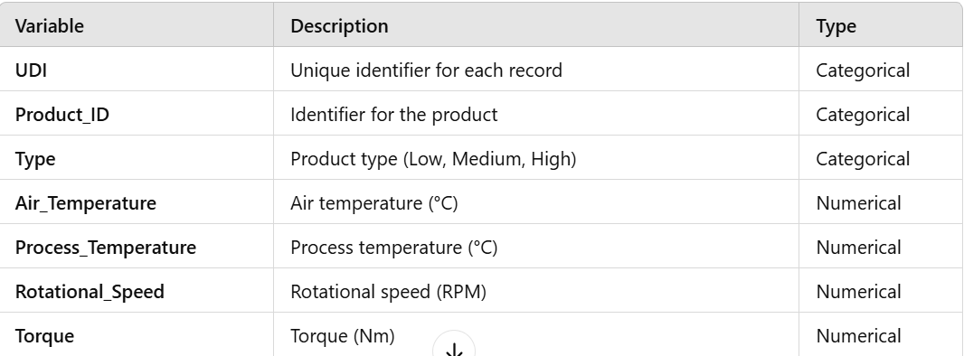
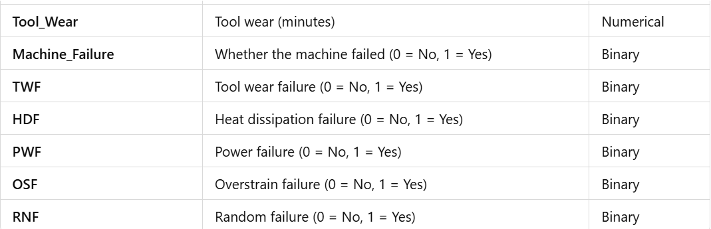
Dataset Overview
Name: AI4I 2020 Predictive Maintenance Dataset
Source: Predictive maintenance for industrial machinery
Records: 10,000 entries
Data Type: Mixed (Numerical and Categorical)
Purpose: Analyze factors influencing machine failures and identify potential predictors for maintenance issues.

Slide 38
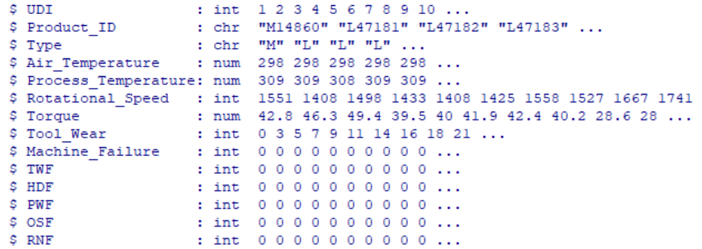
Data Loading and Preparation
Steps Taken:
1. Loaded the Dataset:
Used read.csv() to load the AI4I 2020 Predictive Maintenance dataset.
2. Renamed Columns for Clarity:
Simplified column names for better readability.

Slide 39
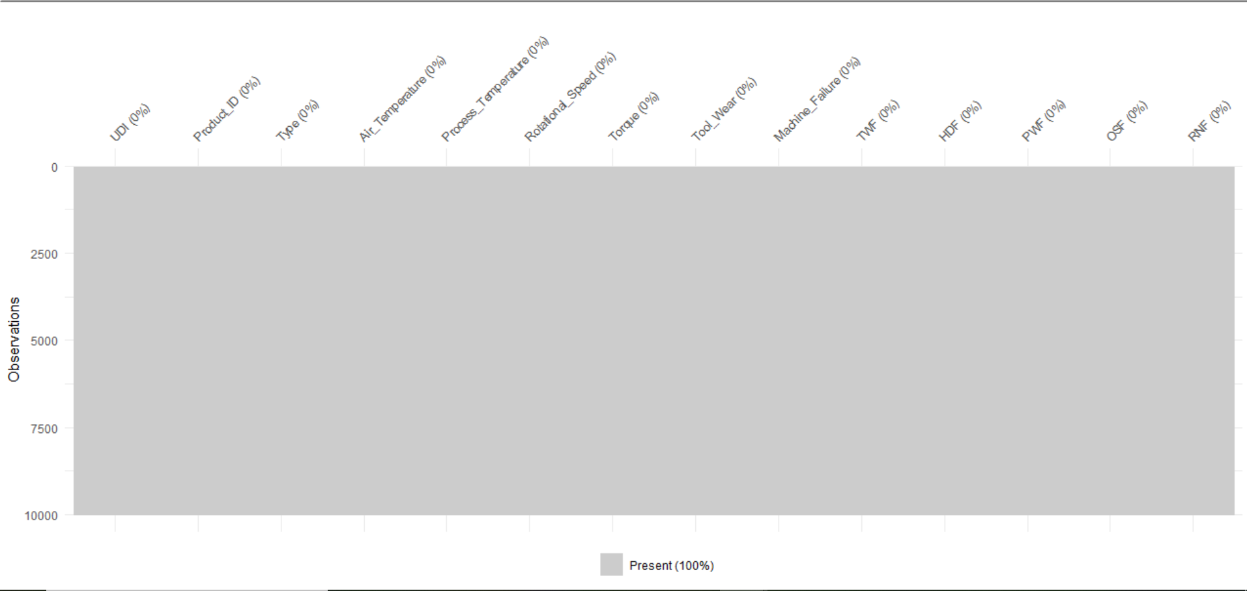
Data Loading and Preparation
Steps Taken:
3. Checked for Missing Values:
Graphical Check: Used vis_miss() to visualize missing data.
Numerical Check: Used mean(is.na(ai4i2020)) to verify the absence of missing values.

Slide 40
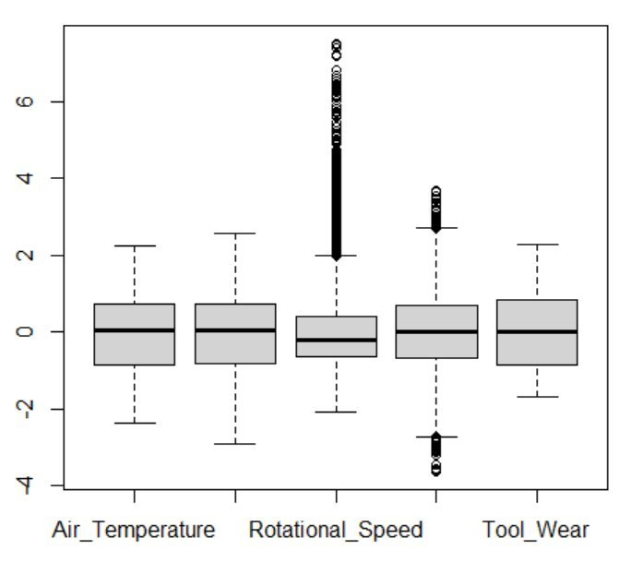
Outliers and Imputation
Steps Taken:
1. Boxplot for Outlier Detection
Description:
Visualization: Boxplots of the scaled numeric variables (Air Temperature, Process Temperature, Rotational Speed, Torque, Tool Wear).
Purpose: To detect outliers in each variable
Observation:
Rotational Speed and Torque have noticeable outliers (values outside the whiskers).

Slide 41
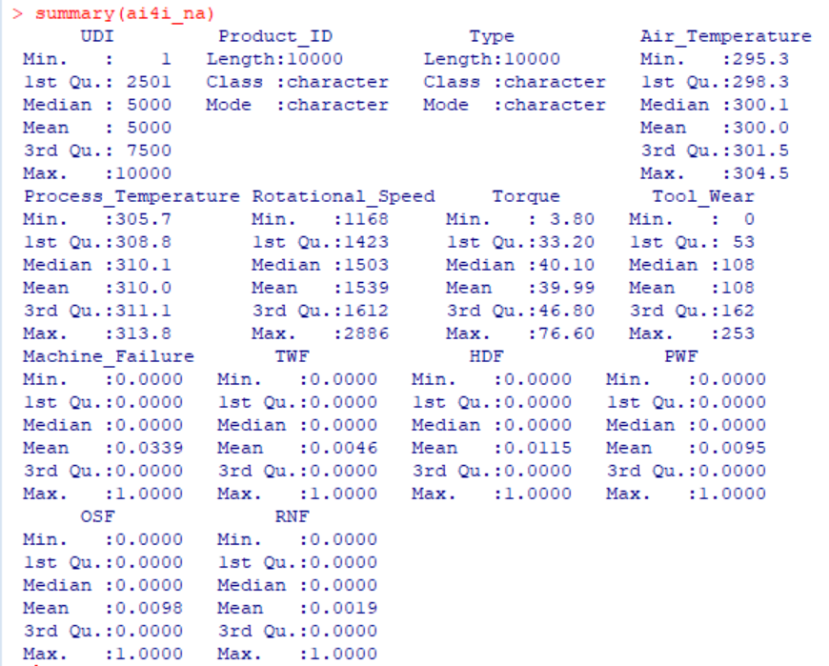
Outliers and Imputation
2. Outlier Imputation with flag_outliers_na()
Description:
Action:
Outliers were replaced with NA using a custom function that calculates the lower and upper bounds based on the Interquartile Range (IQR).
Result:
The summary statistics after this step show NA values in place of outliers for Rotational Speed and Torque.
Steps Taken:

Slide 42
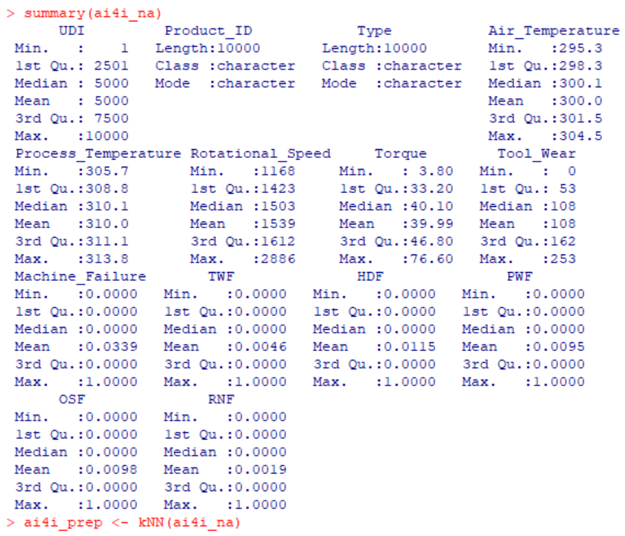
Outliers and Imputation
Steps Taken:
3. kNN Imputation Results
Description:
Action:
The kNN() method was applied to impute the missing values (NA) caused by outlier replacement.
Result:
The summary statistics now show that the NA values have been filled with appropriate values derived from the nearest neighbors.

Slide 43
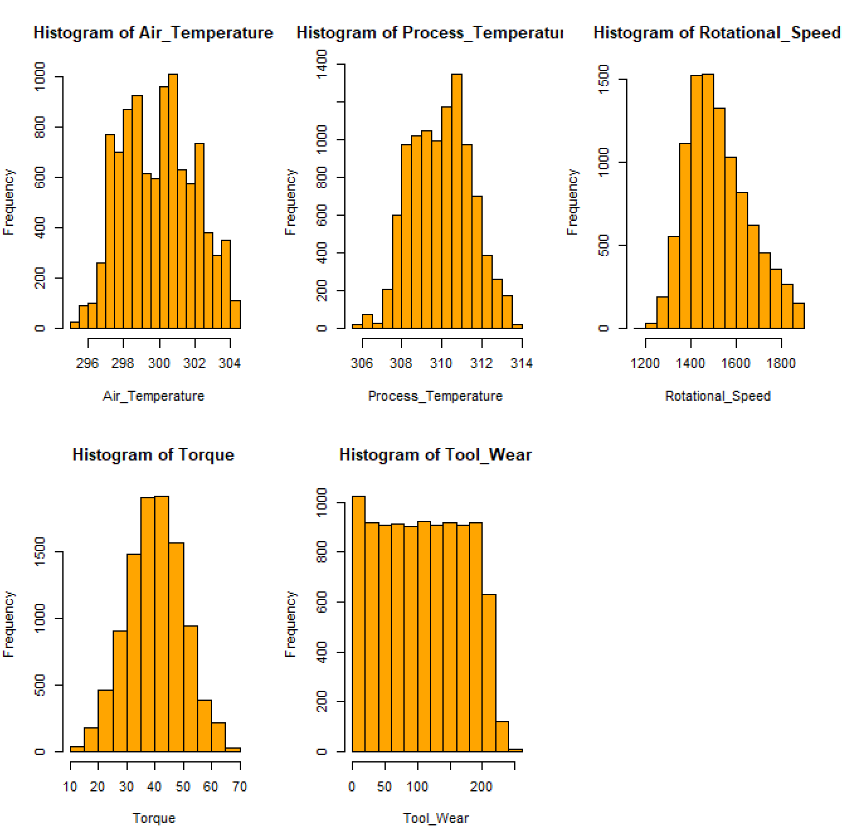
Variable Distributions
Findings:
Torque follows a normal distribution.
Rotational speed is positively skewed.
Other variables do not follow normal distribution.
Venus
Saturn

Slide 44
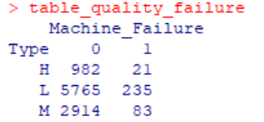
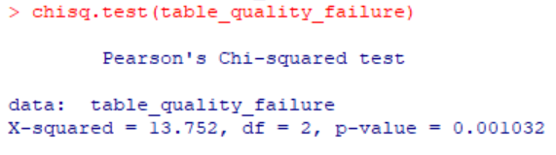
Correlation Matrix
Association between Type and Machine Failure:
Performed a Chi-Square test.
p-value = 0.001032 < 0.05 indicates a statistically significant relationship.

Slide 45
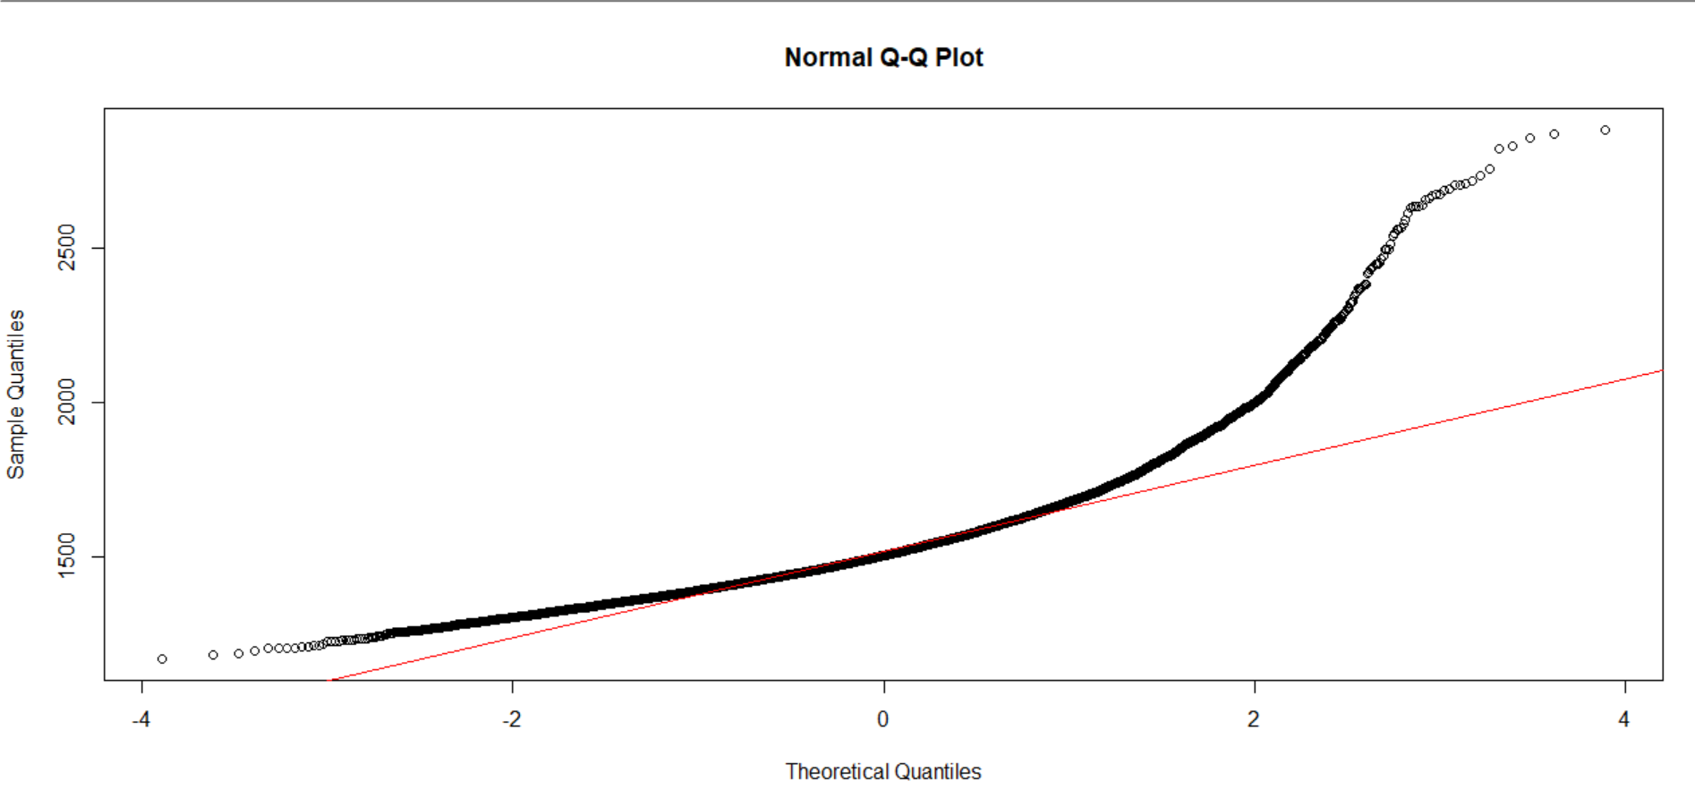
Normality Tests
Association between Rotational Speed and Type
- Normality Tests for Rotational speed: Q-Q Plot for Rotational Speed.
=> The plot showcases deviations in the upper and lower sides suggesting skewness
Venus has extremely high temperatures

Slide 46
Kolmogorov-Smirnov Test
Rotational Speed by Type (Low)
Rotational Speed by Type (med)
Rotational Speed by Type (high)
p-value < 2.2e-16 < 5%
p-value = 2.206e-10 < 5%
p-value = 2.206e-10 < 5%
We can conclude that Rotational Speed doesn't follow a normal distribution in any of the categories

Slide 47
Test for intra-group variance
Since normality is not met, we can't use ANOVA we'll use its non-parametric
alternative kruskal-wallis since Type has 3 categories (H, L , M)
p-value = 0.8498 > 5% meaning there is not a statistically significant difference among the three variant quality products in relation to the rotational speed

Slide 48
Wilcoxon-Mann-Whitney Test for Rotational Speed by Machine Failure
p-value < 2.2e-16 < 5% : Rotational Speed significantly differs between achines that failed vs. those that did not fail.

Slide 49
Association between Rotational Speed and Tool Wear Failure
ks_twf_no_failure
p-value < 2.2e-16 < 5%
ks_twf_yes_failure
p-value = 0.6761 > 5%
We can conclude that Rotational Speed doesn't follow a normal distribution when there's no TWF but follows a normal distribution when there's TWF

Slide 50
Test for intra-group variance - significant difference
Since normality is met for Rotational Speed during a Tool Wear Failure, let's check homogeneity
p-value = 0.7532 > 5% that means homogeneity is met : variances are equal Thus we can run a T-Test
p-value = 0.7073 : there is no significant difference in Rotational Speed between machines with and without Tool Wear Failure.

Slide 51
Wilcoxon-Mann-Whitney Test for Rotational Speed by Machine Failure
p-value = 0.7059 > 5% : this confirms there is no significant difference in Rotational Speed between machines with and without Tool Wear Failure.

Slide 52
Key Findings
Product Type significantly influences Machine Failure.
Rotational Speed does not follow a normal distribution in any category, and non-parametric tests such a kruskall and t_test were used.
Rotational Speed significantly differs between machines that failed vs. those that did not fail, but there is no significant difference in Rotational Speed based on Tool Wear Failure.

Slide 53
Conclusions

Slide 54
—Someone Famous
“This is a quote, words full of wisdom that someone important said and that can inspire the reader.”

Slide 55
9h 55m 23s
333,000
386,000 km
Jupiter's rotation period
The Sun’s mass compared to Earth’s
Distance between Earth and the Moon

Slide 56

A picture is worth a thousand words

Slide 57

A picture always reinforce the concept
Images reveal large amounts of data, so remember: use an image instead of a long text. Your audience will appreciate it.

Slide 58
4,498,300,000
Big numbers catch your audience’s attention

Slide 59
Let’s use some percentages
25%
50%
75%
Mercury
Venus
Mars
Mercury is the closest planet to the Sun and the smallest of them all
Venus has a beautiful name and is the second planet from the Sun
Despite being red, Mars is actually a cold place. It’s full of iron oxide dust

Slide 60

Computer mockup
You can replace the image on the screen with your own work. Just right-click on it and select “Replace image”

Slide 61

Tablet
mockup
You can replace the image on the screen with your own work. Just right-click on it and select “Replace image”

Slide 62
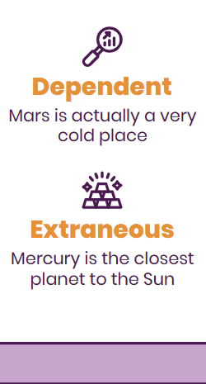
Phone
mockup
You can replace the image on the screen with your own work. Just right-click on it and select “Replace image”

Slide 63
This is a map
Venus
Venus is the second planet from the Sun
Mercury
Mercury is the closest planet to the Sun
Mars
Despite being red, Mars is a very cold place

Slide 64
A timeline always works well
Venus is the second planet from the Sun
Despite being red, Mars is a very cold place
Venus
Mars
Mercury
Jupiter
Mercury is the closest planet to the Sun
Jupiter is the biggest planet of them all

Slide 65
Infographics make your idea understandable
Mars
Venus
Mars is actually a very cold place
Venus has extremely high temperatures
Mercury
Saturn
Mercury is the closest planet to the Sun
Saturn is a gas giant and has several rings

Slide 66
Tables represent your data in a clear way
 | Mass (earths) | Diameter (earths) | Surface gravity (earths)
Mercury | 0.06 | 0.38 | 0.38
Mars | 0.11 | 0.53 | 0.38
Saturn | 95.2 | 9.4 | 1.16

Slide 67
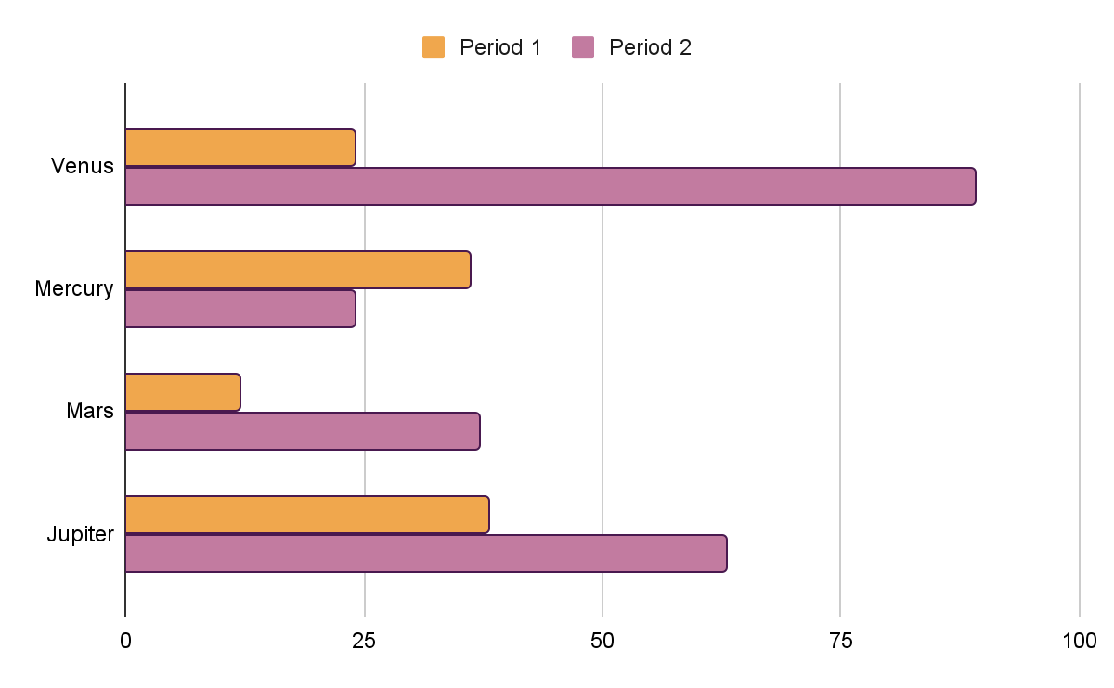
You can use this graph
Mercury
Venus
Jupiter
Saturn
Mercury is the smallest planet
Venus has very high temperatures
Jupiter is the biggest planet
Saturn is a gas giant with rings
Follow the link in the graph to modify its data and then paste the new one here. For more info, click here

Slide 68


Our faculty
Sofia Hill
Kaliyah Harris
You can speak a bit about this person here
You can speak a bit about this person here

Slide 69
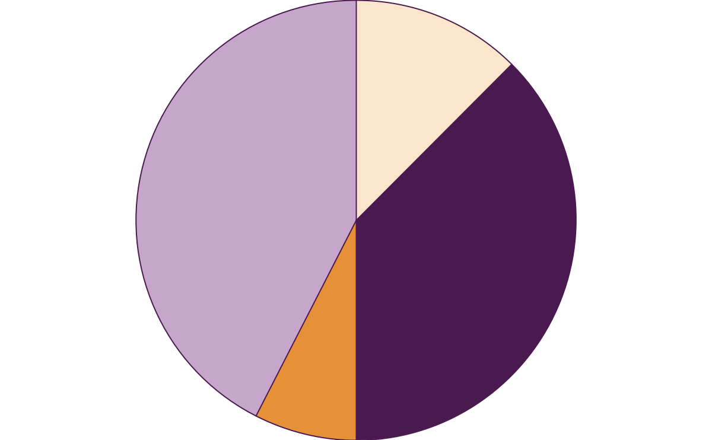
Exercise 1. Frequency
42,5%
12,5 %
2 times
3 times
In a class with 40 children in total, they have been asked about the number of times they do sports per week.
Look at the chart and answer.
What frequency is repeated the most?
7,5 %
37,5 %
4 times
1 time
Follow the link in the graph to modify its data and then paste the new one here. For more info, click here

Slide 70
Interpreting two-way tables
 | Water | Juice
Boys | 8 | 3
Girls | 7 | 5
 | Salty | Sweet
Boys | 5 | 7
Girls | 6 | 9
In a class, boys and girls have been asked about their food preferences. Look at both tables.
How many children prefer to drink water? And juice?
How many girls are there in the sweet/salty group?

Slide 71
Exercise 2 . Complete the table
 | 5 meals | 4 or 3 | TOTAL
Boys | 25 |  | 40
Girls | 30 |  | 40
In a class with 40 boys and 40 girls they have been asked about the number of meals they eat per day. Complete the gap.

Slide 72
Interpreting two events in probability
A
B
A U B =
…
…
…
2
4
3
1
5
Look at the circles and name all individual and common events from cases A and B.

Slide 73
Roll the dice!
Number | 1 | 2 | 3 | 4 | 5 | 6
Probability | 0,12 | 0,14 | 0,16 | 0,17 |  | 0,21
By rolling a six-sided die we have obtained the following results for each number. Calculate the probability for the number 5 and fill the gap.

Slide 74
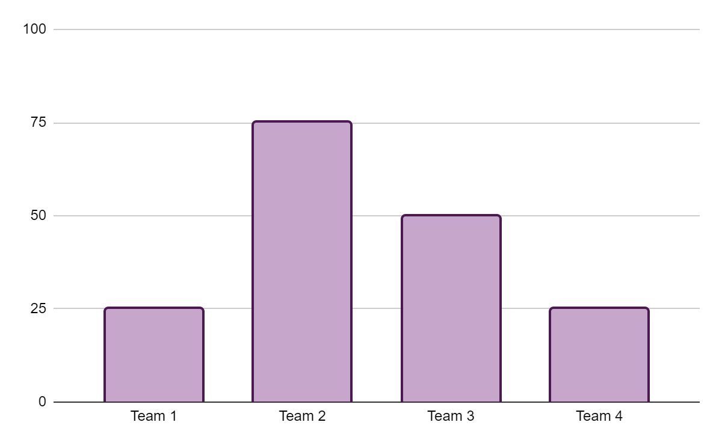
Choose your team!
Look at the graphic and calculate the arithmetic mean and the distribution range of the score obtained by the following soccer teams.
Follow the link in the graph to modify its data and then paste the new one here. For more info, click here

Slide 75
Exercise 3. Events in probability
Sure event | Get a number less than 10
Impossible event
Possible event
3 | 4 | 5 | 6
7 | 5 | 8 | 9
2 | 4 | 2 | 1
Pay attention at the numbers and times they appear. Then, complete the table with 3 possible and impossible events for each gap.

Slide 76
Thanks!
Do you have any questions?
youremail@freepik.com
+34 654 321 432
yourwebsite.com
Please keep this slide for attribution

Slide 77
Icon pack

Slide 78
Alternative resources
Here’s an assortment of alternative resources whose style fits the one of this template:
Vectors
Invest data Semi flat illustrations
Business mission Semi Flat Illustrations
Professional hand drawn infographic elements

Slide 79
Resources
Did you like the resources on this template? Get them for free at our other websites
Vectors
School education subject design icon set
Business crisis Semi Flat Illustrations
Pack de iconos: Economic development | Lineal
Photos
Person doing a presentation for her colleagues
Man showing some infographics in a video call
Front view of smiley female teacher posing in front of blackboard
Female teacher at desk
Icons
Lottery
Dice

Slide 80
Instructions for use
If you have a free account, in order to use this template, you must credit Slidesgo by keeping the Thanks slide. Please refer to the next slide to read the instructions for premium users.
As a Free user, you are allowed to:
Modify this template.
Use it for both personal and commercial projects.
You are not allowed to:
Sublicense, sell or rent any of Slidesgo Content (or a modified version of Slidesgo Content).
Distribute Slidesgo Content unless it has been expressly authorized by Slidesgo.
Include Slidesgo Content in an online or offline database or file.
Offer Slidesgo templates (or modified versions of Slidesgo templates) for download.
Acquire the copyright of Slidesgo Content.
For more information about editing slides, please read our FAQs or visit our blog:
https://slidesgo.com/faqs and https://slidesgo.com/slidesgo-school

Slide 81
Instructions for use (premium users)
As a Premium user, you can use this template without attributing Slidesgo or keeping the Thanks slide.
You are allowed to:
Modify this template.
Use it for both personal and commercial purposes.
Hide or delete the “Thanks” slide and the mention to Slidesgo in the credits.
Share this template in an editable format with people who are not part of your team.
You are not allowed to:
Sublicense, sell or rent this Slidesgo Template (or a modified version of this Slidesgo Template).
Distribute this Slidesgo Template (or a modified version of this Slidesgo Template) or include it in a database or in any other product or service that offers downloadable images, icons or presentations that may be subject to distribution or resale.
Use any of the elements that are part of this Slidesgo Template in an isolated and separated way from this Template.
Register any of the elements that are part of this template as a trademark or logo, or register it as a work in an intellectual property registry or similar.
For more information about editing slides, please read our FAQs or visit our blog:
https://slidesgo.com/faqs and https://slidesgo.com/slidesgo-school

Slide 82
Fonts & colors used
This presentation has been made using the following fonts:
Poppins
(https://fonts.google.com/specimen/Poppins)
#f0a74d
#ffffff
#c7a6cc
#49194f
#fce5cd
#f7ecf8
#c27ba0
#e69138
#b45f06

Slide 83





Storyset
Create your Story with our illustrated concepts. Choose the style you like the most, edit its colors, pick the background and layers you want to show and bring them to life with the animator panel! It will boost your presentation. Check out how it works.
Pana
Amico
Bro
Rafiki
Cuate

Slide 84
Use our editable graphic resources...
You can easily resize these resources without losing quality. To change the color, just ungroup the resource and click on the object you want to change. Then, click on the paint bucket and select the color you want. Group the resource again when you’re done. You can also look for more infographics on Slidesgo.

Slide 87
JANUARY
FEBRUARY
MARCH
APRIL
MAY
JUNE
PHASE 1
Task 1
Task 2
PHASE 2
Task 1
Task 2
JANUARY
FEBRUARY
MARCH
APRIL
PHASE 1
Task 1
Task 2

Slide 90
...and our sets of editable icons
You can resize these icons without losing quality.
You can change the stroke and fill color; just select the icon and click on the paint bucket/pen.
In Google Slides, you can also use Flaticon’s extension, allowing you to customize and add even more icons.

Slide 91
Educational Icons
Medical Icons

Slide 92
Business Icons
Teamwork Icons

Slide 93
Help & Support Icons
Avatar Icons

Slide 94
Creative Process Icons
Performing Arts Icons

Slide 95
Nature Icons

Slide 96
SEO & Marketing Icons

Slide 97


